Slide 1
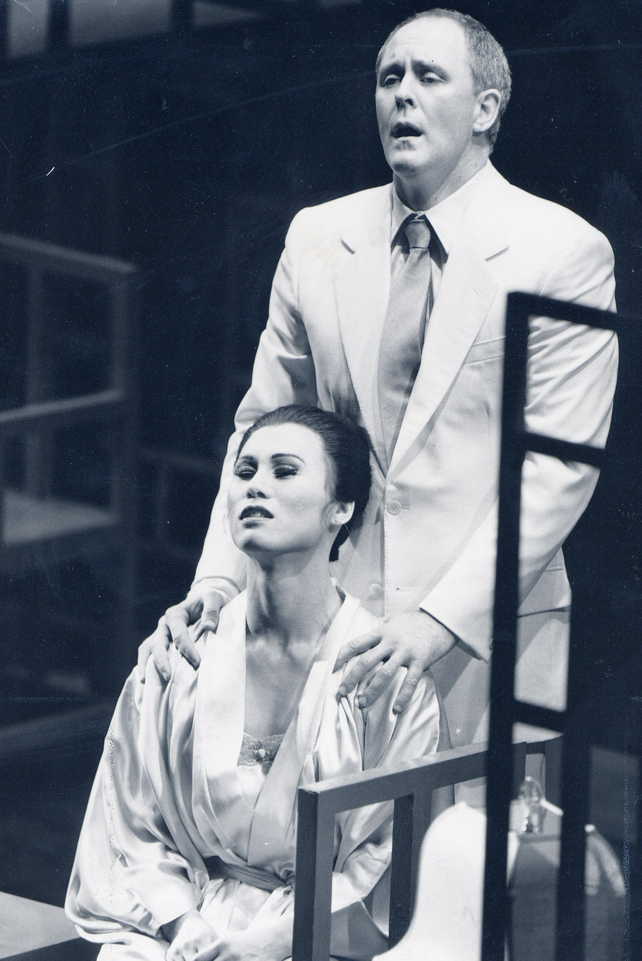
Week 6 Monday
This week:
--for Wed. Read: “For the First Time, the Real-Life Models for Broadway’s M. Butterfly Tell of their Very Strange Romance,” Wadler
--Paper topics are on Canvas
Optional paper topic meetings with your section leader: see your leader for sign ups
Next week:
Midterm Week Wed. in lecture; McBurney students have been sent codes and must make an appointment for testing.
John Lithgow and B.D. Wong, M. Butterfly on Broadway, 1988

Slide 2
Midterm: 50 min. Wed. 10/18 in lecture
5 short passages or images (10 points each) taken from the reading through M. Butterfly.
addressed in lecture (whether on the lecture slides or not).
The goal of the exam is to reveal that you:
completed the reading
attended lecture
can produce close, analytical, evaluative interpretation

Slide 3
Structure: As on the practice exam, The directions on the exams will read:
Read the entire exam first. You may respond to the passages in any order as long as your responses are numbered corresponding to the exam sheet. Skip a line between lettered sections within your response to each question. Return this exam with your bluebook.
A. Identify the passage by title and author’s last name. (2 points)
B. Contextualize the passage or image in regard to the plot of the novel, play, or short story OR the content and argument of the essay, or the overall meaning of the poem or photograph, e.g. What is this work “about”? This segment of the exam relies on your recall and study of individual works. You might consider who is speaking and how the passage, scene, or image is pivotal to the work as a whole. (3 points)
C. Analyze the passage or image in a close reading with specific attention to course themes and lecture content. Why is this passage, scene, or image significant? Are there multiple ways to interpret the passage or image that contrast with our lecture framing? Is it controversial in any way? How would you evaluate it? You might consider the language of the passage or composition of the image. (5 points)

Slide 4
A. Yang, American Born Chinese
B. Describe the plot, conflict, and resolution of this novel in your own words. What is this novel about? If this were an article, describe the contents and argument of the article.
C. Discuss the composition of this image [color, arrangement, text] and how it conveys the themes of the plot. Does these image compliment those themes or does it complicate them?
If this were an article passage, how is the word choice significant? How does it connect with larger themes suggested in lecture? Do you agree or disagree with the argument suggested by the passage? Why?
Your responses should be at least 1-1.5 pages of a bluebook with B. responses being 3-4 sentences and C. between 4-6 sentences.

Slide 5
Closed book exam
Write your name on the bluebook.
Or
On your laptop, close all browsers and
Open a word file and save it with the title:
Last Name, first name, midterm1, Section leader’s name
Save your work throughout the session.
When you are finished, put the exam sheet in your bluebook and quietly return both to the front next to your section sign-in. Or Turn in the exam sheet and quietly check in with your section leader to make sure your Canvas upload appears in the correct place.

Slide 6
John Lithgow and B.D. Wong, M. Butterfly on Broadway, 1988
Foundation:
What is the nature of this play’s critique about race and gender relations?
How does it convey this?
Complications:
--Some interpretive twists:
Solicit volunteers for an exercise
Bigger takeaways:
the role of fantasy in desire
I.6 p. 17: inverting the plot of the opera, Madame Butterfly
III.1 p. 82; audio:
“Rule Two: As soon as a Western man . . . ”

Slide 7
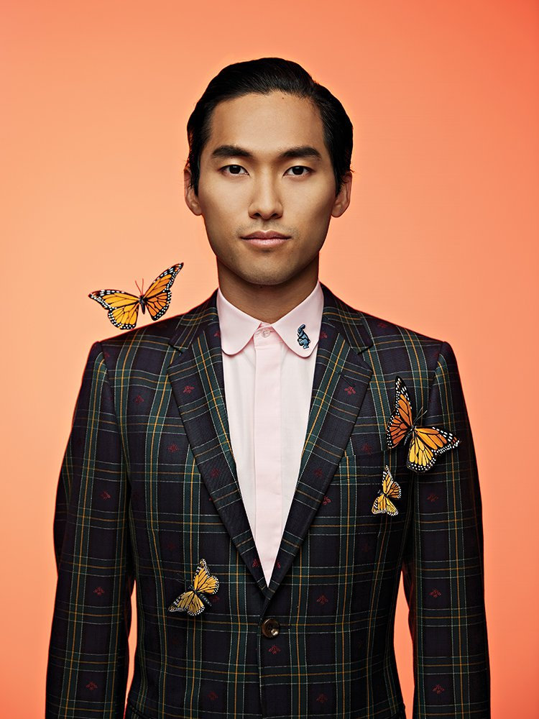
Relevance of M. Butterfly in 2017
David Henry Hwang:
“Gallimard falls into a relationship with an Asian woman who he believes to be sort of submissive and extrapolates from that how the West should deal with the East politically.
Today, when we have a president who feels that the way to deal with North Korea or Muslim countries or whatever is by being tougher and more abrasively masculine, that feels to me incredibly consistent with the story ‘M. Butterfly’ is trying to tell.”
Cited in “New Flight for a New ‘Butterfly,’” Laura Collins-Hughes, New York Times, Online Oct. 17, 2017.
Jin Ha in the revival of M. Butterfly, 2017

Slide 8
If you agree, walk to the podium. If you disagree, stay where you are.
I found Gallimard to be a sympathetic character.
Gallimard is the author of his own deception.

Slide 9
If you agree, walk to the podium. If you disagree, stay where you are.
Gallimard is in love with an ideal that Song projects.
Gallimard is in love with Song.
Once Song's deception is revealed, Gallimard is effectively disempowered.

Slide 10
If you agree, walk to the podium. If you disagree, stay where you are.
Song's motivations for deceiving Gallimard are straightforward. Song is “in love with” power, acting, manipulation, their own ego.
Song's motivations for deceiving Gallimard are straightforward. Song is in love with Gallimard.
Song is a patriot and loves his country, the People’s Republic of China.

Slide 11
If you agree, walk to the podium. If you disagree, stay where you are.
The misconceptions and fantasies that haunt Gallimard’s relationship with Song could happen to anyone.

Slide 12
Gallimard is in love with an ideal that Song projects.
Song's motivations for deceiving Gallimard are fairly straightforward. Song is “in love with” power, acting, manipulation, their own ego.

Slide 13
I.5.10
I found Gallimard to be a sympathetic character.
Gallimard is the author of his own deception.

Slide 14
Week 7 Wed.
Read: “For the First Time, the Real-Life Models for Broadway’s M. Butterfly Tell of their Very Strange Romance,” Wadler
Upcoming Week 8:
M: continue M. Butterfly
W: Midterm 1
Jin Ha in the revival of M. Butterfly, 2017

